Slide 1
PSAT, SAT, & ACT
COLLEGE ENTRANCE EXAMS

Slide 2
Common Myths
The SAT is an IQ test.
The ACT is easier.
Only take the ACT if you’re good at science.
Competitive schools only accept the SAT.

Slide 3
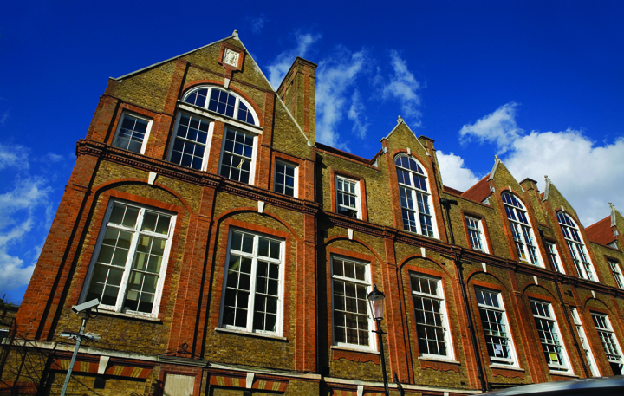
What Do Colleges Think?
Facts:
Nearly all schools accept the SAT or ACT.
89% of schools use SAT or ACT test scores in making admissions decisions*
Source: National Association of College Admissions Counseling, “Preparation for College Admissions Exams”, 2009

Slide 4
BENEFITS OF THE PSAT/NMSQT
Preparation for the SAT®
Scholarship and recognition opportunities (11th grade)
College and career planning tools (My College QuickStart™)
Admissions and financial aid information from colleges
Feedback on academic skills

Slide 5
How does the PSAT/NMSQT ® compare to the SAT®?
Question Types:
  The same, except the PSAT/NMSQT does not have an essay component.
Length:
  The PSAT/NMSQT is 2 hours, 10 minutes.
  The SAT is 3 hours, 45 minutes.
Level of Difficulty:
  The PSAT/NMSQT does not have 11th grade-level math questions.

Slide 6
The SAT at-a-Glance
SECTION | FORMAT/ TIME | QUESTION TYPES | SCORE | 2010 Averages
MATH | 3 SECTIONS | MULTIPLE CHOICE GRID-INS | 200-800 | 516
CRITICAL READING | 3 SECTIONS | MULTIPLE CHOICE | 200-800 | 501
WRITING | 3 SECTIONS | MULTIPLE CHOICE ESSAY | 200-800 0-12 | 492 7.1
EXPERIMENTAL | 1 SECTION | MULTIPLE CHOICE | NOT SCORED | N/A
TOTAL | 10 SECTIONS, 3 HOURS, 45 MINUTES | MULTIPLE CHOICE GRID-INS ESSAY | 600-2400 | 1590

Slide 7
Writing/English (60 minutes):
  Essay (25 min)
  Grammar/Usage/Writing Process
  multiple choice (35 min)
Mathematics (70 minutes):
  Algebra I
  Geometry
  Mathematical Reasoning
  Algebra II
Critical Reading (70 minutes):
  Mixture of long and short reading passages (science, history, humanities, literature)
  Sentence Completion

Slide 8

Understanding SAT Scoring
Correct Answer: +1 point
Omitted Question: 0 points
Incorrect Answer (multiple choice): -1/4 point
Incorrect Answer (non-multiple choice math questions): 0 points
Test Day Tip:
If you can eliminate 1 answer choice, guess!

Slide 9
About SAT Subject Tests
SAT Subject Tests allow you to showcase your accomplishments and interest in subjects in which you do well. They provide a more complete story about your academic abilities and distinguish you in the admission process.
For admission
    Certain schools require or recommend them as part of the admission process.
  For placement and advising
    Placement out of beginner classes allows you to focus on more interesting/in-depth classes and satisfy basic requirements for certain majors prior to attending college.
    College advisers use them to help you pick course subjects and levels

Slide 10
About SAT Subject Tests
  Subject Tests cover content knowledge in:
  Literature U.S. History Biology
  Math Level 1 World History Chemistry
  Math Level 2 Physics
  Foreign language Subject Tests measure reading comprehension, language usage and vocabulary. Some of these tests have a listening component:
  Spanish Chinese French
  Japanese German Korean
  Modern Hebrew Latin Italian

Slide 11
The ACT at-a-Glance
SECTION | FORMAT/ TIME | QUESTION TYPES | SCORE | 2010 Averages
ENGLISH | 1 SECTION | MULTIPLE CHOICE | 1-36 | 20.5
MATH | 1 SECTION | MULTIPLE CHOICE | 1-36 | 21.0
READING | 1 SECTION | MULTIPLE CHOICE | 1-36 | 21.3
SCIENCE | 1 SECTION | MULTIPLE CHOICE | 1-36 | 20.9
WRITING | 1 SECTION | ESSAY (OPTIONAL) | 1-36 2-12 | 20.8 7.1
TOTAL | 4–5 Sections 2 hours, 55 minutes 3 hours, 25 minutes | MULTIPLE CHOICE ESSAY | 1-36 | 21.0

Slide 12
Understanding ACT Scoring
Correct Answer: +1 point
Omitted Question: 0 points
Incorrect Answer: 0 points
Test Day Tip:
Answer every question. If you don’t know the answer, guess!

Slide 13

ACT has “Science” reasoning questions.
ACT has four trigonometry questions.
SAT essay is required and first.
ACT essay is last and not always required.
SAT is 20 minutes longer.

Slide 14
STRATEGIES FOR SUCCESS

Slide 15

College Prep Timeline
Extracurricular activities
Prep for AP/Honors
PSAT in October
Take AP and SAT Subject Tests after completing courses
Summer prep for PSAT

Slide 16

College Prep Timeline
PSAT in October for National Merit
Focus on academics—this is the critical year!
Research admissions requirements for chosen schools
Prepare for SAT and/or ACT, take in the spring
Take required SAT Subject Tests
Take SAT and/or ACT for the last time (Fall)
Take required SAT Subject Tests
Request letters of recommendation
Fill out FAFSA and research scholarships
Visit schools

Slide 17
Prep Smarter, Not Harder!
Apps that are FREE!
SAT PREP
ACT PREP
The Official SAT Question of the Day
IntelliVocab for SAT
SAT Up
Kaplan SAT Flashcubes
ACTstudent

Slide 18
Practice Test Websites
SAT PREP
www.blinetestprep.com
ACT PREP
http://www.actstudent.org/sampletest/
Kaplan’s free SAT-ACT Combo test

Slide 19
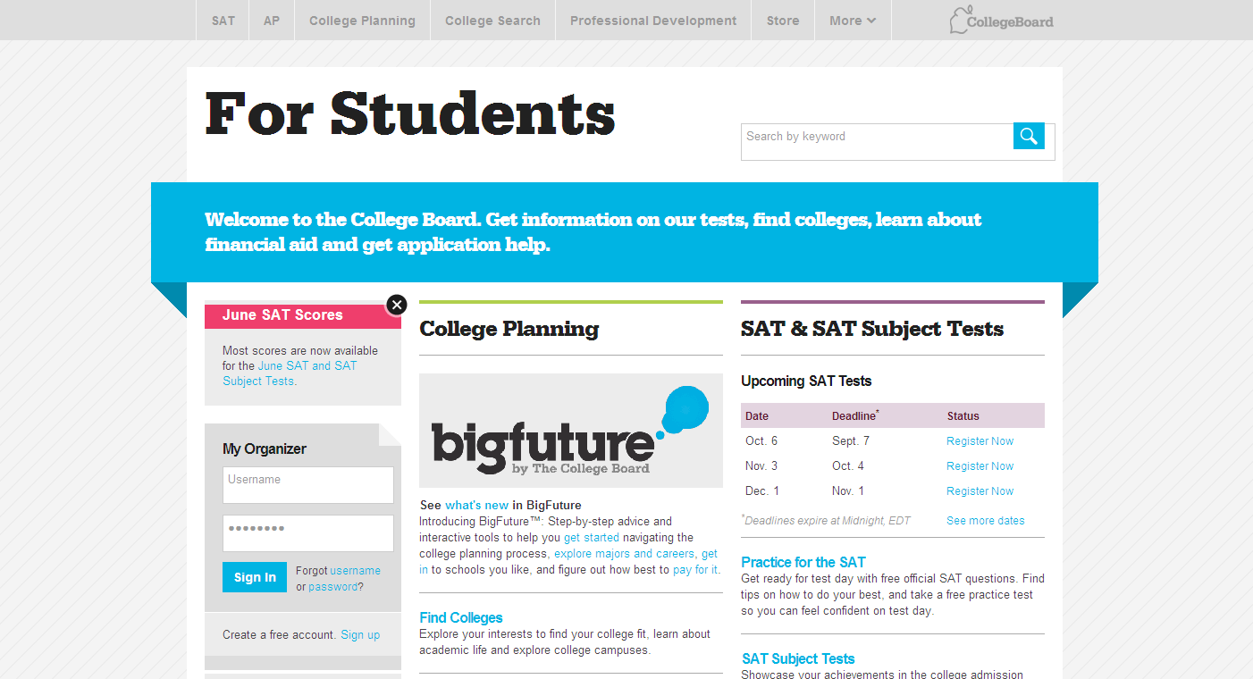
Visit collegeboard.org

